Slide 1
Synod profile 2024
SOUTHEASTERN PENNSYLVANIA SYNOD, ELCA

Slide 2
This profile of the Southeastern Pennsylvania Synod was developed as an equivalent to a congregational Ministry Site Profile. The Transition Team’s intention was to provide:
About this presentation
an overview of the synod territory and congregational composition,
a general explanation of the synod’s finances,
information about Rostered Ministers, the Conference Deans and Synod Staff,
the role of the Bishop, and
the results of a synod-wide survey intended to highlight the qualities needed in a bishop and the current vitality of the synod.
ABOUT THIS PRESENTATION

Slide 3
The information presented in this document has been accessed through a variety of sources. When appropriate, the source material will be indicated by an endnote reference. Much of the congregational data was obtained from the ELCA’s churchwide offices and comes from the 2022 annual Congregational Reports. This data was received by the synod office in September 2023. Data for 2023 will not be available until autumn of 2024. Please note that not all of the synod’s congregations completed their 2022 report. Typically, the ELCA will use the most recent numbers received when current data is unavailable. It may be helpful to remember that like all reports of this kind, this is a ”snapshot” in time.
ABOUT THIS PRESENTATION

Slide 4
Synod overview
General Information about our Synod and Region

Slide 5
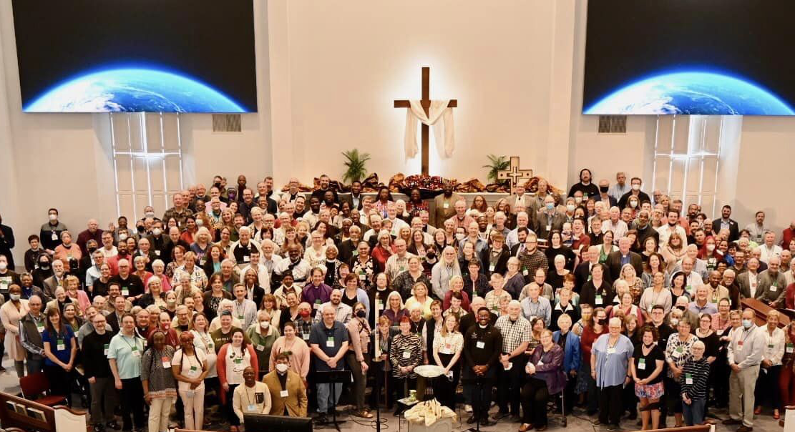
OUR MISSION
Activated by the gifts
of the Holy Spirit,
we equip the saints,
for building up
the body of Christ.
Synod Assembly, 2023
SYNOD OVERVIEW

Slide 6
The Southeastern Pennsylvania Synod (SEPA) is comprised of the people of God in 146 congregations and a variety of other ministries, all doing God’s work together.
SYNOD OVERVIEW

Slide 7
Synod territory²
SYNOD OVERVIEW

Slide 8
The SEPA synod territory includes Bucks, Chester, Delaware, Montgomery and Philadelphia counties which cover 2154 sq. miles.
SYNOD OVERVIEW

Slide 9
THE SYNOD IS DIVIDED INTO 8 CONFERENCES
CONFERENCES | CONGREGATIONS
Central Philadelphia | 13
Chester | 15
Delaware | 21
Lower Bucks | 16
Lower Montgomery | 24
Northeast/Northwest Philadelphia | 15
Upper Bucks | 24
Upper Montgomery | 18
SYNOD OVERVIEW

Slide 10
General population of the region¹⁰

Slide 11
SYNOD MEMBERSHIP AS PERCENTAGE OF REGIONAL POPULATION⁴
SYNOD OVERVIEW

Slide 12
ORGANIZED CONGREGATIONS IN SYNOD
End of year statistics reported to ELCA.⁴
SYNOD OVERVIEW

Slide 13
SYNOD CONGREGATIONS BY SIZE
OF AVERAGE WEEKLY WORSHIP ATTENDANCE
Corporate Congregation AWWA = 351 - 800
Program Congregation AWWA = 151 - 350
Pastoral Congregation AWWA = 51 - 150
Small Congregation AWWA = 1 - 50
These terms are used and defined by the ELCA.
SYNOD OVERVIEW

Slide 14
REPORTED BAPTIZED MEMBERSHIP
End of year statistics reported to ELCA.⁴
SYNOD OVERVIEW

Slide 15
Changes in membership statistics⁴
SYNOD OVERVIEW

Slide 16
RACIAL DIVERSITY IN 5 COUNTY REGION²
SYNOD OVERVIEW

Slide 17
VISUAL COMPARISON OF RACIAL DIVERSITY
IN THE REGION VS. SEPA SYNOD⁴
SYNOD OVERVIEW

Slide 18
PERCENT OF CONGREGATIONS REPORTING
MULTIRACIAL PARTICIPANTS
Statistics from submitted ELCA Congregational Reports⁴
Note: these statistics were obtained from congregations where there is more than one racial or ethnic group represented in the membership. Congregations that have no racial diversity are not included.
SYNOD OVERVIEW

Slide 19
PERCENTAGE BREAKDOWN BY RACE
OR ETHNICITY OF CONGREGATIONAL MEMBERS in 2022
Statistics from submitted ELCA Congregational Reports⁴
For the purposes of this chart, White participants were excluded. They make up 85.90% of the reported membership. The remaining 14.10% are reflected in the pie chart.
SYNOD OVERVIEW

Slide 20
LANGUAGES USED IN WORSHIP⁴
English
Spanish
German
Korean
American Sign Language
SYNOD OVERVIEW

Slide 21
2022 Modes of worship attendance⁴
Note: 96 congregations reported weekly online worship services in 2022.
100 congregations projected providing weekly online worship in 2023.⁴
SYNOD OVERVIEW

Slide 22
2022 reported membership and worship attendance
SYNOD OVERVIEW

Slide 23
Synod FINANCES
Synod Budget, Assets and Congregational Giving Patterns,

Slide 24
FINANCIAL OVERVIEW
The slide that follows is a summary of the Synod’s operations for the years ending on January 31, 2023, 2022, 2021and 2020 is presented in the table in millions of dollars.
NOTE: SEPA uses a fiscal year beginning on February 1 and ending on January 31 of the following year. Hence operating figures reflect revenues received and expenses incurred primarily in the prior year.³
SYNOD FINANCES

Slide 25
Finances³
 | 2023 | 2022 | 2021 | 2020
OPERATIONS
Congregational and partnership Support | $1.6 | $1.7 | $1.7 | $1.7
Other* | 0.9 | 0.4 | 0.5 | 1.4
Revenue** | 0.6 | 0.9 | 0.6 | 0.4
TOTAL | $3.1 | $3.0 | $2.8 | $3.5
EXPENSES*** | $2.5 | $2.4 | $2.4 | $2.6
TOTAL INCOME IN EXCESS OF EXPENSES | 0.6 | 0.6 | 0.4 | 0.9
Nonoperating income (expense)**** | (2.0) | 0.9 | 1.4 | 4.7
NET INCREASE (DECREASE) IN NET ASSETS | ($1.4) | $1.5 | $1.8 | $5.6
*Primarily beneficial interest in perpetual trust.
** Primarily income from investments.
*** Includes approximately a 0.8 million contribution to the ELCA each year. Also included are operating expenses of $1.4 million in 2023, $1.3 million in 2022, $1.3 million in 2021, and $1.6 million in 2020.
**** Primarily reportable fluctuations in market value of investments and, in 2020, proceeds less expenses from the sale of Church property.

Slide 26
Synod assets
The Synod’s net assets were $13.5 million in 2023, $14.9 million in 2022, $13.4 million in 2021, and $11.6 million in 2020. The 1.4 million decrease in 2023 is primarily a result of the decline in market value of investments. Although a gain or loss is not realized until the investment is sold, for accounting purposes, it must be reported in the period in which the market value changed. Investments as reported on the Synod’s balance sheet were valued at $9.8 million in 2023, $10.7 million in 2022, $9.4 in 2021 and $6.2 million in 2020.⁹
Of primary concern is the decline in contributions from congregations’ partnership support since the pandemic. The Synod sends 50% of contributions from congregations to the ELCA. The decline in these contributions not only negatively affects the Synod but also the ELCA. Also, it should be noted that, the decline has continued thus far in the 2024 fiscal year.
Proceeds from the sale of church properties was $0.5 million in 2022, $0.5 million in 2021, and 4.3 million in 2020. No church properties were sold in 2023. The property of closed congregations is transferred to the Synod and subsequently sold. This trend indicates that struggling congregations are closing and thus, eroding the Synod’s support base.
It should be noted that the gains and losses from investments as reported above include changes in the market value of these investments. Changes in the market value of investment are not realize until the investment is sold or redeemed. With the market’s volatility recently, future swings may cause significant changes in the Synod’s net assets.³
SYNOD FINANCES

Slide 27
disbursement breakdown for 2022³
SYNOD FINANCES

Slide 28
Annual Giving per worship attendee⁴
SYNOD FINANCES

Slide 29
2022 mission support by conference⁹
SYNOD FINANCES

Slide 30
SYNOD LEADERSHIP
Information about Rostered Leaders
Survey of the Conference Deans and Synod Staff

Slide 31
Ministers of word & Service
24 on Synod Roster¹¹
SYNOD LEADERSHIP: ROSTERED MINISTERS

Slide 32
Years in ministry for the 5 active
Ministers of word and service¹¹
SYNOD LEADERSHIP: ROSTERED MINISTERS

Slide 33
Ministers of word & SACRAMENT
260 on Synod Roster¹¹
SYNOD LEADERSHIP: ROSTERED MINISTERS

Slide 34
Years in ministry for active
Ministers of word and sacrament¹¹
SYNOD LEADERSHIP: ROSTERED MINISTERS

Slide 35
Gender distribution
of those in active ministry¹¹
SYNOD LEADERSHIP: ROSTERED MINISTERS

Slide 36
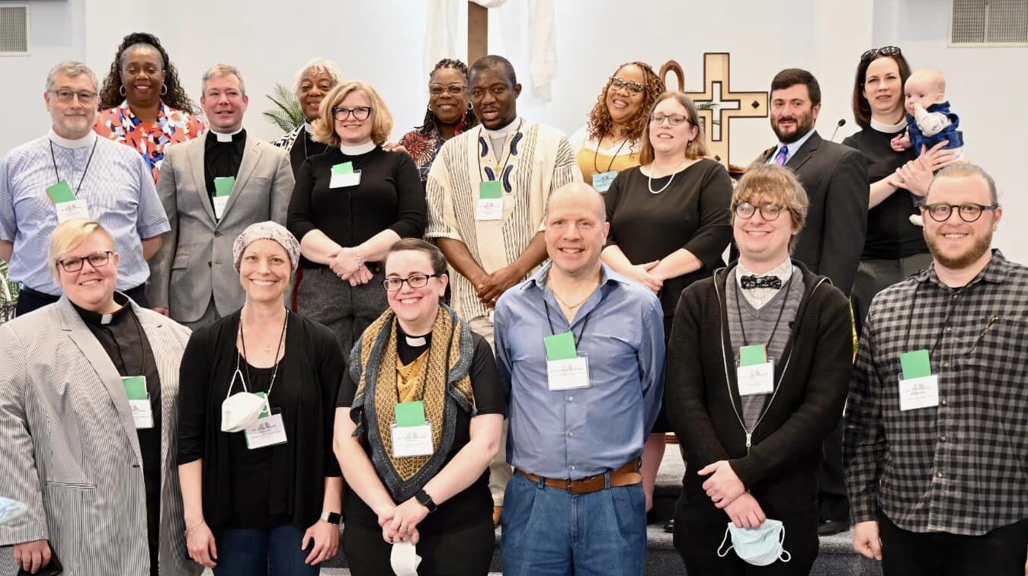
Survey of deans and synod staff
Synod staff and Conference Deans were sent a short open answer survey designed to hear their thoughts on how their role relates to the role of the Bishop in SEPA Synod.⁵
SYNOD LEADERSHIP: DEANS AND STAFF

Slide 37
SURVEY PARTICIPANTS
The survey was conducted online and was distributed in November of 2023.
Recipients included the twelve Synod staff members, the eight Conference Deans, the Chair of the Candidacy Committee and the Dean of the Interim Pastors. They were given the option of submitting their responses with their name or anonymously.
Ten responses out of a possible 22 were received.
SYNOD LEADERSHIP: DEANS AND STAFF

Slide 38
1: Can you name and describe your role as it relates to the office of the Bishop?⁵
Participants describe their roles as:
Bishop's additional eyes and ears in the conference.
Part of the committee which make decisions to approve candidates to be ordained into the office of Word and Sacrament, or the office of Word and Service.
Responsible for providing direct support to Mission Developers and new ministries exploration and initiatives
Part of Dean’s table with the Bishop
Part of Churchwide staff
Responsible for staff work for the functions of candidacy, mobility, fundraising, and first call education that are under the Bishop's purview.
Provide assistance to other synod staff with writing grants
SYNOD LEADERSHIP: DEANS AND STAFF

Slide 39
2: What does the new bishop need to know about your role?⁵
Conference deans have enjoyed a close working relationship with the bishop.
The deans are here to help, have a unique vantage point on the synod, and will offer whatever support that they can.
There is a lot of wisdom around that the Dean’s table and it is all there to support the bishop and share the weight of leadership.
As one who is appointed by the Bishop I serve as long as the Bishop desires.
The new experiment of the DEM role being shared between two rostered ministers has worked well so far. Other synods across the ELCA are doing the same and it looks like it is here to stay. The DEMs also serve effectively as congregational pastors.
We are all in this together.
There is a team mentality that we are all working for the good of the church, which makes the process work so much easier.
This is vital as we move forward
SYNOD LEADERSHIP: DEANS AND STAFF

Slide 40
Responses to Question 2 continued
The new bishop needs to be aware of the financial and building problems congregations are facing.
If there is no progress made, there will no longer be congregations in the inner city of Philadelphia.
My role works for me as it has been configured- but it might not work this well for someone else.
That my role has a huge portfolio .
Doing what I can to keep all these ministry areas functioning.
To add more to my plate or take some of these roles to the next level, admin support would be necessary.
Deans do a lot of work on the ground in our conferences.
Often times deans are elected because no one wants to do the extra work, which puts extra burden on those individuals.
The compensation doesn't match the amount of work or pressure.
SYNOD LEADERSHIP: DEANS AND STAFF

Slide 41
3: What skills or gifts are most essential for
a person standing for election as our next Bishop?⁵
Ten responses were received.
1 = 10%
1 = 10%
6 = 60%
8 = 80%
4 = 40%
4 = 40%
4 = 40%
4 = 40%
1 = 10%
10 = 100%
SYNOD LEADERSHIP: DEANS AND STAFF

Slide 42
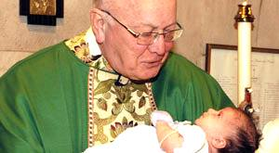
4: How would you define the role of bishop in SEPA?⁵
Leader for the overall oversight and support of
congregations while supporting the clergy that
serve them.
Listener. Listening allows the Bishop to offer
a vision for the synod that is informed by
various voices and will include and require
the work of all our hands.
Listening first and foremost to God in prayer and trusting that God will speak, trusting that God is with us every step of the way, and that we do not have to be afraid.
Listening to leaders, to the pastors, to the people in the congregations each expressing their perspective, their hopes, their fears.
Central spiritual and moral leader of our Synod who leads by public example.
SYNOD LEADERSHIP: DEANS AND STAFF

Slide 43
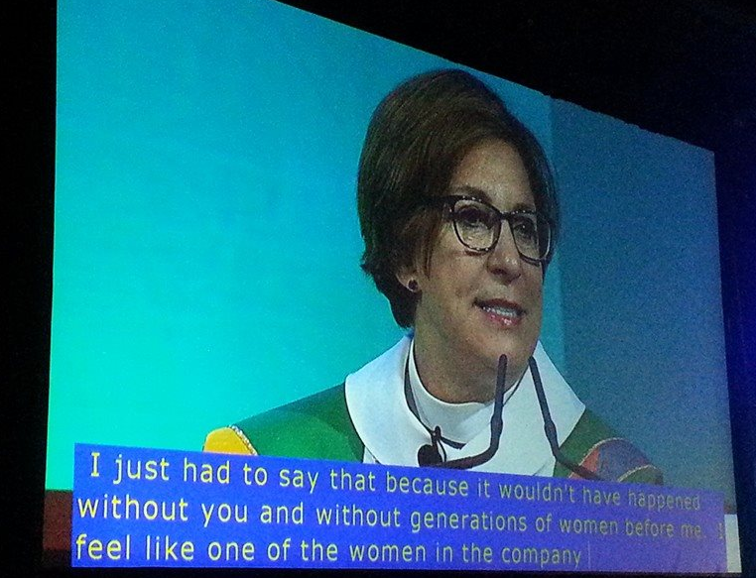
Responses to Question 4 continued
The bishop is first and foremost the pastor to the Rostered Leaders of this Synod. They should support us so the we can support our congregations through pastoral care, worship leadership, and the sacraments.
They, and their office and staff, provide resources, guidance, and aid to congregations in difficult, turbulent, or transitional times.
The bishop has a ceremonial role of being with churches and leaders for celebrations, anniversaries, and other social events.
The role of the bishop is to cast the vision and to develop followers into leaders. They are the coach, cheerleader, equipper, and truth teller, empowering others to lead, convening various task force groups.
SYNOD LEADERSHIP: DEANS AND STAFF

Slide 44
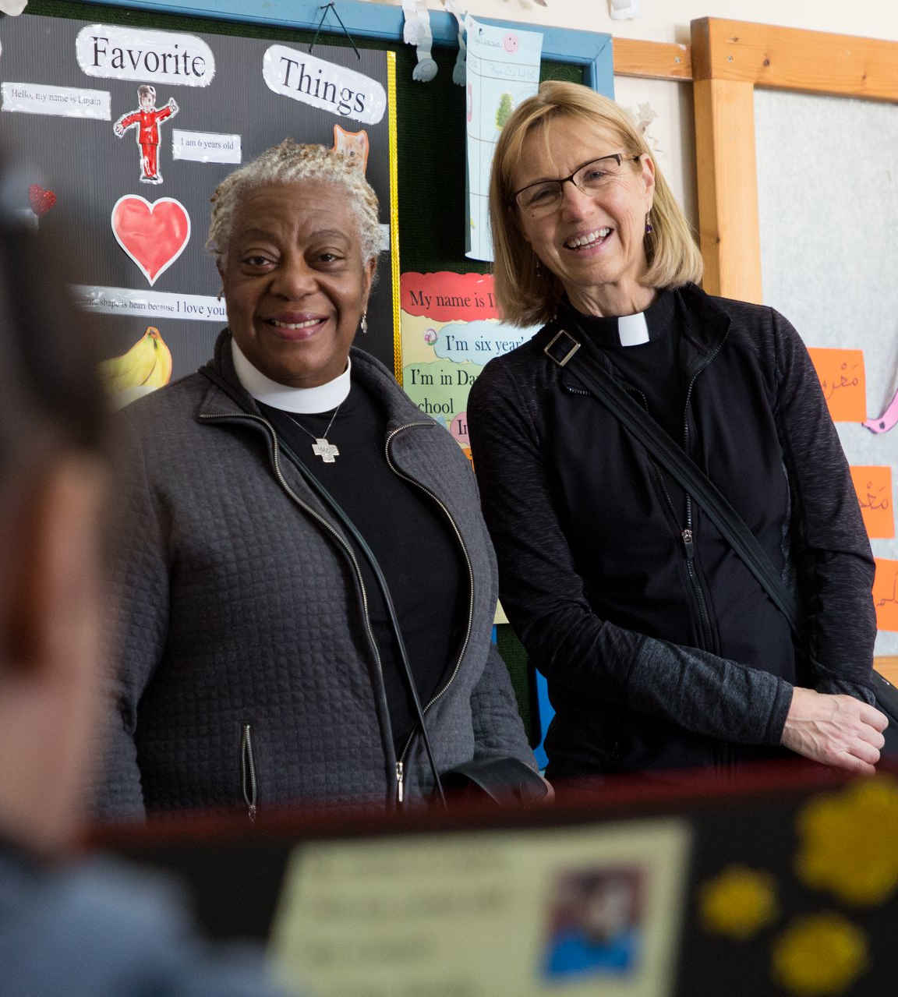
Responses to Question 4 continued
As defined by the constitution, the role of bishop is primarily administrative. This administration is greatly enhanced by someone who can:
cast a vision and build the relationships to make it happen.
be at the forefront of the public ministry of the church in our area.
Have a firm grasp of administration and organizational aspects of the role..
The role of the bishop should not only cast a vision, but also have or develop a clear plan as to how to get there.
SYNOD LEADERSHIP: DEANS AND STAFF

Slide 45
5: How do you think the role of bishop may change over the next 3-6 years?⁵
The bishop will be more involved in encouraging collaboration between a smaller number of stronger churches.
The bishop will lead creative ways to address a growing clergy shortage.
The church has been in a time of transition for a while now and that is likely to continue, and perhaps even accelerate in many ways.
The bishop will need to be the one who continues to ask what’s possible, what we can do, what new ideas we haven’t tried yet, rather than be someone who tells us what we’ve always done, or what isn’t possible.
They will need to be someone who is open and flexible, someone who thinks outside the box, someone who challenges the synod and its rostered leaders to do the same.
SYNOD LEADERSHIP: DEANS AND STAFF

Slide 46
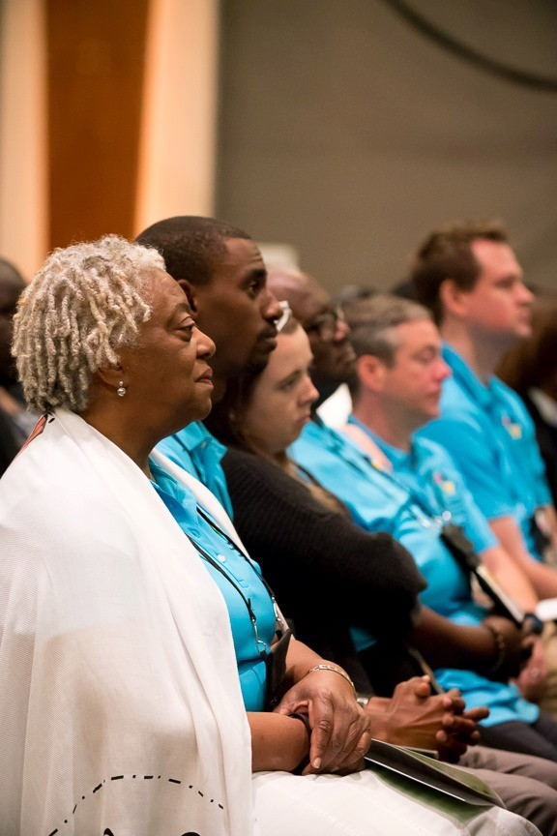
Responses to Question 5 continued
The bishop will need to be a faith leader, someone who continues to remind us over and over again that God has this, that God is at work, in our midst, and that while the church may change, God’s presence and God’s love never does.
They will need to change as the landscape of the church changes. My guess is there will be more Holy Closures and yoking of congregations.
They will need to address interim ministry, lay ministry, and declining funding in ways that their predecessors did not have to consider.
They will still deal the impacts of the endemic and current ministry realities.
The bishop will have to be a more agile thinker and innovator as the role of pastor and the calls that are available continue to change.
SYNOD LEADERSHIP: DEANS AND STAFF

Slide 47
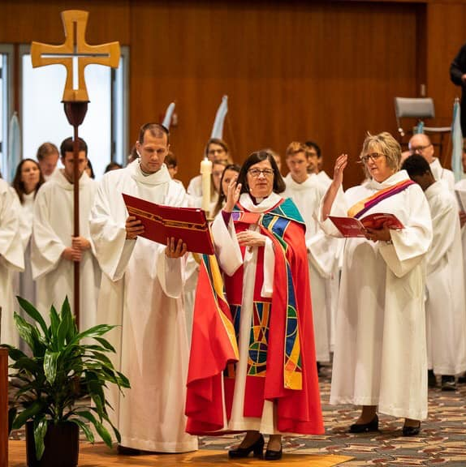
Responses to Question 5 continued
The bishop will be in a process and the length of that process is determined by the vision and gifted ears and tongue with spiritual thought.
This role could significantly change as the church continues to experience accelerated levels of change.
Congregations will be looking to the bishop as they feel the impact of the leadership crisis and shrinking financial realities over their next term.
SYNOD LEADERSHIP: DEANS AND STAFF

Slide 48
Responses to Question 5 continued
In addition to the bishop’s role within our synod:
They will become a public and regional witness to our faith, inviting new people into the Lutheran tradition. I would like to see our new Bishop be on social media, television, and radio talking about what we believe and how we put faith into action regarding important social justice matters.
Though the ELCA's future church strategy and the Renewing Lutheran Church commission are both currently doing their work, the next bishop will likely need to act on how we live into that future before the recommendations of those groups are ready.
The Bishop will lead the evolution of the church in the next phase of the church's life.
SYNOD LEADERSHIP: DEANS AND STAFF

Slide 49
6: What would success look like for a bishop?⁵
Having stronger congregations that are more closely connected to each other and the synod.
It’s hard to measure -likely be a moving target over the course of their term.
Making connections, with leaders, pastors, and laypeople.
Creating spaces where people feel like they can speak and feel heard. I think success also looks like a willingness to try new things, even if they fail.
Continuing to learn and grow, being curious and not assuming we know the answers already.
Making the Lutheran Church, our beliefs, our faith, our teachings, known outside of our Lutheran Circle.
The church growing both in new people and in stronger faith and witness to our Lord.
SYNOD LEADERSHIP: DEANS AND STAFF

Slide 50
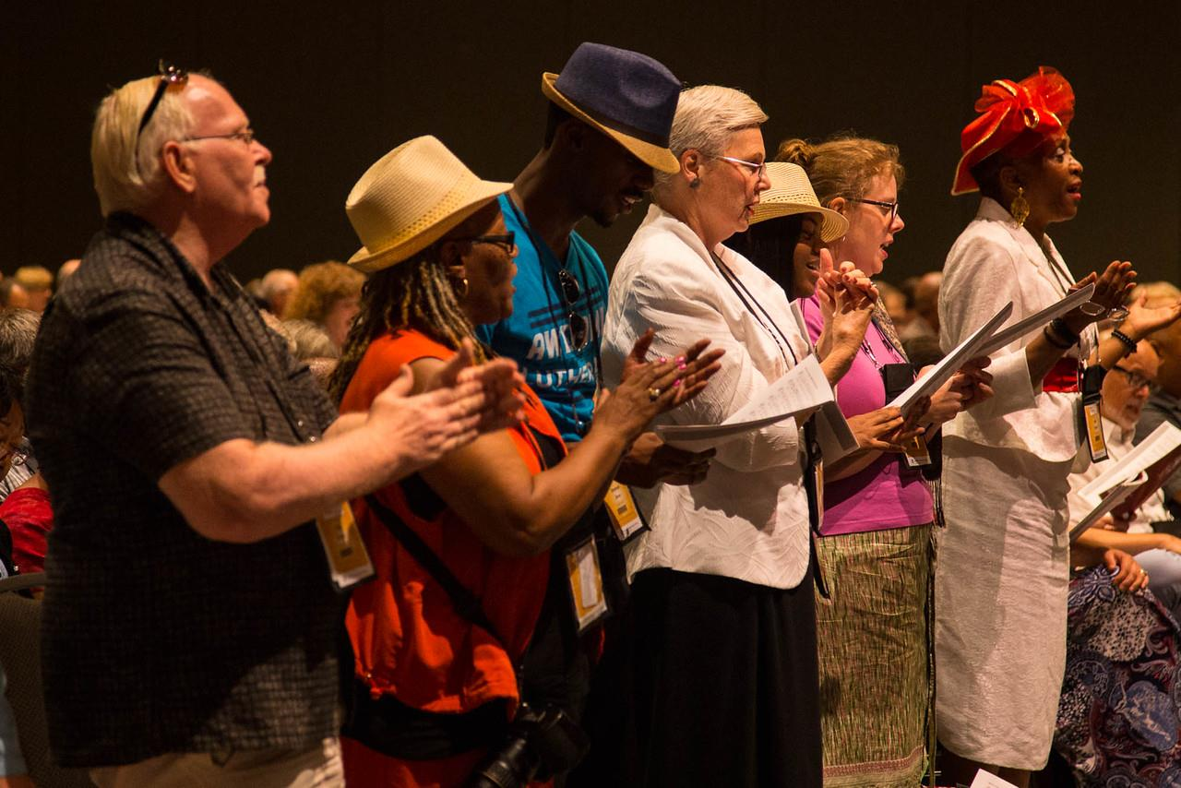
Responses to question 6 continued.
Continuation of the current synod ministries and new ones that will continue to enhance the vision and mission of the synod.
A thriving synod moving forward and bringing the congregations along side.
Healthy and passionate lay leaders,
Congregations playing a vital role in their communities
Thriving witnesses to the gospel in as many communities as we can get them in.
Vital, passionate, growing ministry with the Bishop's office offering support and encouraging new ways of doing church.
SYNOD LEADERSHIP: DEANS AND STAFF

Slide 51
Other Feedback from the Deans and Synod Staff⁵
I would like the next bishop to have a proven track record of effective and creative parish ministry.
I am thankful for Bishop Davenport, for her faith, leadership, example and witness.
Without constitutional change, the Bishop's ability to change the realities of their call will be limited.
Hopefully the next bishop will also help the Synod leaders navigate the coming changes in the churchwide organization.
SYNOD LEADERSHIP: DEANS AND STAFF

Slide 52
The role of bishop
As summarized from the Constitution of the Southeastern Pennsylvania Synod.
Thoughts from Bishop Patricia Davenport.
Ministries, Teams and Boards

Slide 53
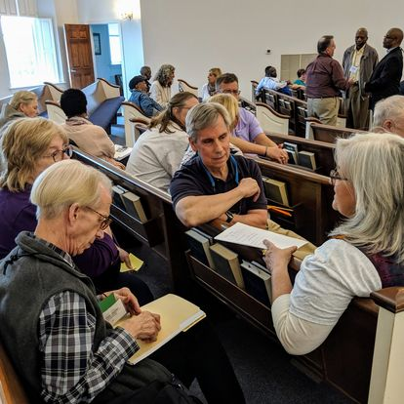
The Synod’s constitution states that the bishop shall be elected by the Synod Assembly.
The bishop shall be a minister of Word and Sacrament of the Evangelical Lutheran Church in America.¹
CONSTITUTIONAL ROLE OF BISHOP

Slide 54
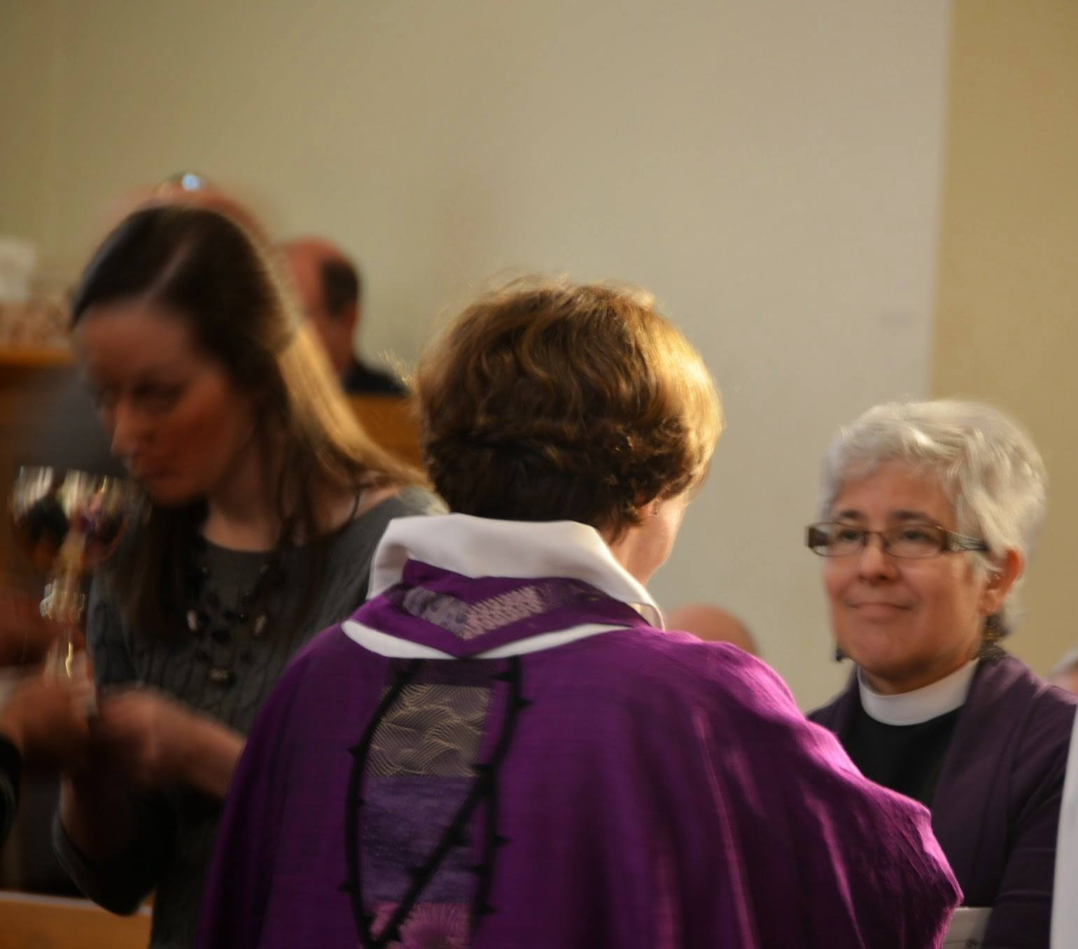
In union with all ELCA ministers of Word and Sacrament the bishop is called to speak publicly to the world in solidarity with the poor and oppressed, advocating dignity and justice and equity for all people, working for peace and reconciliation among the nations, caring for the marginalized, and embracing and welcoming a racially and ethnically diverse population.¹
CONSTITUTIONAL ROLE OF BISHOP

Slide 55
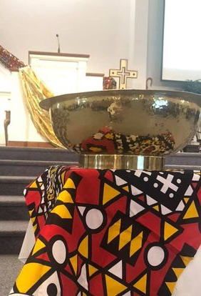
As this synod’s pastor, the bishop shall preach, teach, and administer the sacraments in accord with the Confession of Faith of this church; provide pastoral care and leadership for this synod, its congregations, its ministers of Word and Sacrament, and its ministers of Word and Service; ordain, consecrate and install rostered ministers.¹
CONSTITUTIONAL ROLE OF BISHOP

Slide 56
The bishop shall exercise leadership in the mission of this church and in so doing: interpret and advocate the mission and theology of the whole church; lead in fostering support for and commitment to the mission of this church within this synod; coordinate the use of the resources available to this synod as it seeks to promote the health of this church’s life and witness in the areas served by this synod.
The bishop shall submit a report to each regular meeting of the Synod Assembly concerning this synod’s life and work; and advise and counsel this synod’s related institutions and organizations.¹
CONSTITUTIONAL ROLE OF BISHOP

Slide 57
The bishop shall practice leadership in strengthening the unity of the Church and in so doing:
exercise oversight of the preaching, teaching, and administration of the sacraments within this synod in accord with the Confession of Faith of this church;
be responsible for administering the constitutionally established processes for the resolution of controversies and for the discipline of rostered ministers and congregations of this synod.¹
CONSTITUTIONAL ROLE OF BISHOP

Slide 58
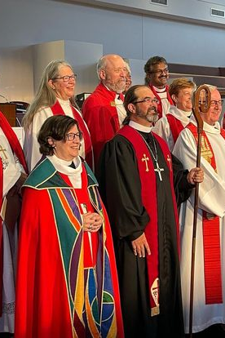
The bishop shall
be the chief ecumenical officer of this synod;
be a member of the Conference of Bishops and consult regularly with other synod bishops;
foster awareness of other churches throughout the Lutheran world communion and, where appropriate, engage in contact with leaders of those churches;
cultivate communion in faith and mission with appropriate Christian judicatory leaders functioning within the territory of this synod; and
be ex officio a member of the Churchwide Assembly.¹
CONSTITUTIONAL ROLE OF BISHOP

Slide 59
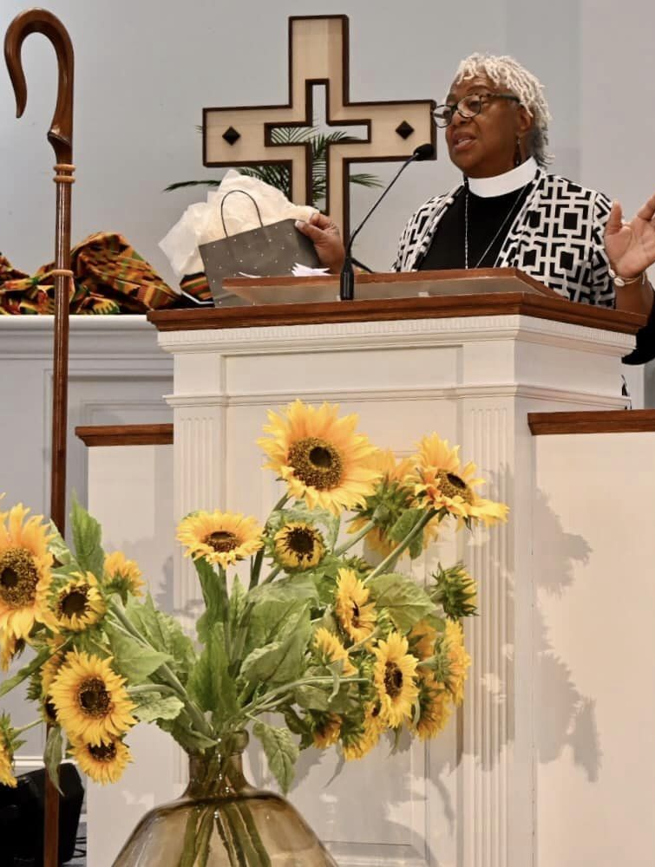
The bishop shall oversee and administer the work of this synod, serving as president of the synod corporation and be the chief executive and administrative officer of this synod; presiding at all meetings of the Synod Assembly and provide for the preparation of agendas; ensuring that the constitution and bylaws of the synod and of the churchwide organization are duly observed within this synod, and that the actions of the synod in conformity therewith are carried into effect; etc.¹
CONSTITUTIONAL ROLE OF BISHOP

Slide 60
The bishop shall
direct and guide the work of the other synod officers;
exercise supervision over the work of all synod staff members;
appoint all committees for which provision is not otherwise made;
be a member of all committees and any other organizational units of the synod, except as otherwise provided in this constitution;
provide for preparation and maintenance of synod rosters annually
provide for prompt reporting to the secretary of this church as stipulated in the constitution
provide for preparation and maintenance of a roster of the congregations of this synod and the names of the laypersons who have been elected to represent them; and
appoint a statistician of the synod.¹
CONSTITUTIONAL ROLE OF BISHOP

Slide 61
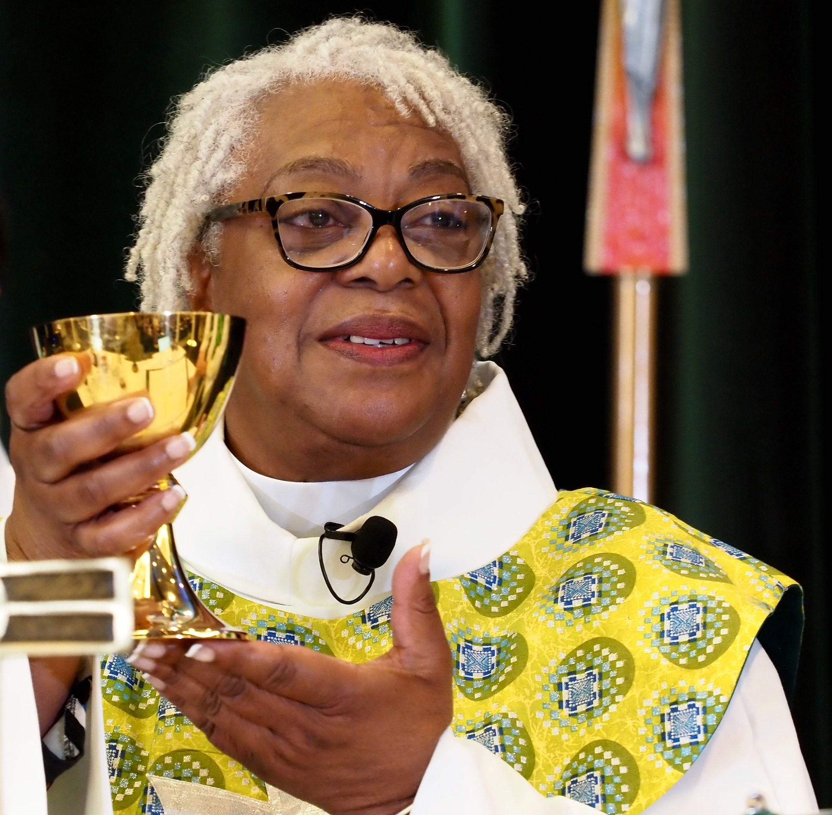
THOUGHTS FROM BISHOP DAVENPORT⁷
The Role of the Bishop is fundamentally what is written in the ELCA Constitution. The constitutional role has not changed and is accurate, but
It changes depending on what is going on in the church and the world.
It will be defined by the new bishop.
It will be shaped by world and local events.
It is to be discerned in conversation with constituents.
It is and will be led by the Holy Spirit and the voice of God.
It is defined by how it is lived and how you show up.
THE ROLE OF THE BISHOP

Slide 62
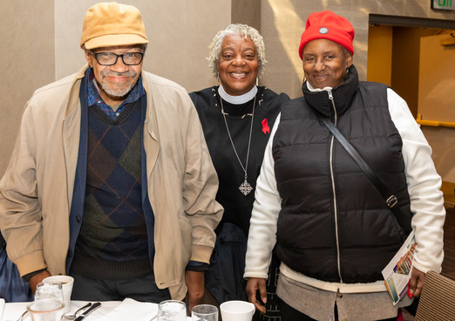
It’s being the pastor to the pastor in times of crisis.
Being called during a pandemic meant
a real shift.
The normal order ramped down and new
ways of being amped up.
There was a flurry to figure out how to do
communion and how to continue to worship together.
Led to an appreciation of holy cyberspace and how to worship in and out of the sanctuary
Pastors became First Responders. The bishop needed to be there for them, to have their back as they made decisions and to help them with making tough decisions.⁷
THE ROLE OF THE BISHOP: THOUGHTS FROM BISHOP DAVENPORT

Slide 63
The Role of Bishop is always changing.
Changes can be based on church and civil leadership
Who will be elected president?
Dealing with red, blue and purple political divisions has become a large part of family and church life. How do we have these conversations?
Who are key leaders within the ELCA?
Change can center on the theological conversations that are happening in people’s homes and in our churches.
The expectations of the Role of Bishop are doable.
When they are lived out based on the synodical make-up
They require mindfulness toward healthy balance and self care.⁷
THE ROLE OF THE BISHOP: THOUGHTS FROM BISHOP DAVENPORT

Slide 64
What are the gifts of the synod?
Great Group of New Ordained Ministers
New sense of kin-dom building
Leaning into sharing faith and pursuing justice
See us going full steam ahead with a new mindset: It is on because in spite of it all, we are called to share the good news of Jesus Christ.
Willing to take a stand
The clergy gap is shrinking
Strong and emerging Lay Leaders
The synod is raising up a group of lay leaders equipped to serve that will assist in addressing clergy shortage. (Synodically authorized Lay Ministers.)⁷
THE ROLE OF THE BISHOP: THOUGHTS FROM BISHOP DAVENPORT

Slide 65
How the role is lived out
By God’s grace
With strong faith
By being surrounded by good staff and good leaders
Knowing that prayer life is essential and foundational. Begin and end each day and every meeting with prayer.
Modeling leadership supported by prayer and reflection. (Jesus took time away and apart and then made decisions.)⁷
THE ROLE OF THE BISHOP: THOUGHTS FROM BISHOP DAVENPORT

Slide 66
Bishop Davenport’s thoughts on the gifts most needed
Administration
Knowing (learning) how systems work (ELCA, synod, congregations)
Ability to build relationships and work with a wide variety of people.
Willingness to get to know all of the players
Knowledge of budget building
Willingness to show up
Have a spirit wide open to loving
“Your gifts will make room for you.”⁷
THE ROLE OF THE BISHOP: THOUGHTS FROM BISHOP DAVENPORT

Slide 67
Groups & Ministries the bishop connects with regularly
Throughout the year the bishop meets with a variety of groups, task forces, committees and boards. Many of these commitments are mandated by the synod or organizational constitutions such as the Synod Council, the Conference of Bishops and United Lutheran Seminary. Others are based on the current organizational structure of the synod. Additionally, each bishop may find that they are invited to participate on a committee or board based on their personal gifts and interests.
THE ROLE OF THE BISHOP

Slide 68
Office of the Bishop
Synod teams and committees¹²
Synod Council
Administration
Audit Committee
Constitution Committee
Consultation Committee
Executive Committee
Finance Committee
Investment Committee
Nominating Committee
Process for Holy Closure of Congregations
Council Officers Network
Committee of Deans and Eight Conference Networks
Transition Ministry Development Team
Intentional Interim Ministry
Bishop Election Teams
Transition
Discernment
Election
THE ROLE OF THE BISHOP: TEAMS AND COMMITTEES

Slide 69
Communications/Mission Interpretation
Congregation Communicators Network
Assembly/Event Media Team
Now Normal Colleague Group
Finance and Development
Finance Committee
Fund for Mission
Forward Together in Faith Grant Team
Congregational Vitality
Congregational Vitality Team
Resource Vision and Mission Partnership
Generosity Team
ELCA Coaching Network
Love Revolution Team
Mission Developers/Strategic Ministry Leaders
THE ROLE OF THE BISHOP: TEAMS AND COMMITTEES

Slide 70
Other Teams and Networks¹²
The Anti-Racism Team
The African Descent Lutheran Association (ADLA)
diakonia™ Program Faith Formation Team
Lutheran Advocacy Ministry in Pennsylvania (LAMPa)
Lutheran Disaster Response-Eastern PA
Enthusiastic Learners Delightfully Enjoying Retired Status (ELDERS)
Religious Leaders Council of Greater Philadelphia
Zones of Peace
Black Clergy of Philadelphia and Vicinity
SEPA Women of the ELCA (SEPA WELCA)
Synod Hunger Team
Urban Ministry Taskforce
SEPA Deputy Network
Clergy Compensation Guidelines Team
THE ROLE OF THE BISHOP: TEAMS AND COMMITTEES

Slide 71
Organizations and Boards¹²
North Eastern Diocese of Evangelical Lutheran Church Tanzania
Tanzania Companionship Team
Bear Creek Camp
Diakon Lutheran Social Ministries
Gemma Services
KenCrest Services
Lutheran Advocacy Ministry in Pennsylvania
Lutheran Immigration and Refugee Service
Liberty Lutheran Services
Artman
Hearth at Drexel
Lutheran Disaster Response
Paul’s Run
Village at Penn State
West Philadelphia Senior Community Center
Lutheran Settlement House
Thrivent
United Lutheran Seminary
THE ROLE OF THE BISHOP: ORGANIZATIONS AND BOARDS

Slide 72
SEPA SURVEY SUMMARY
Results of the Questionnaire:
November 27 - December 11, 2023

Slide 73
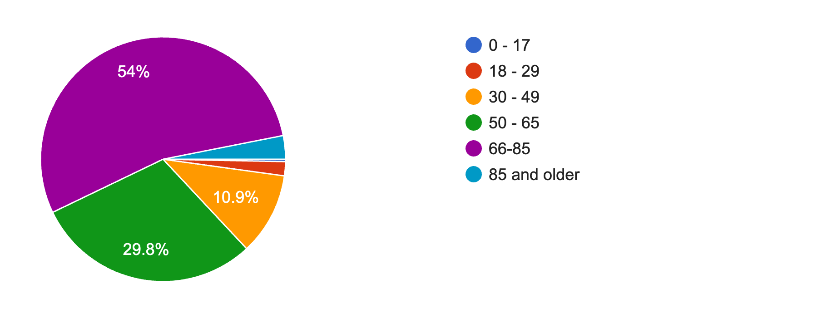
322 SURVEY PARTICIPANTS
1. What is your age?⁶
0 – 17 (1)
18- 29 (6)
30 -49 (35)
50 -65 (96)
66 -85 (174)
85 & older (10)
SURVEY PARTICIPANTS

Slide 74
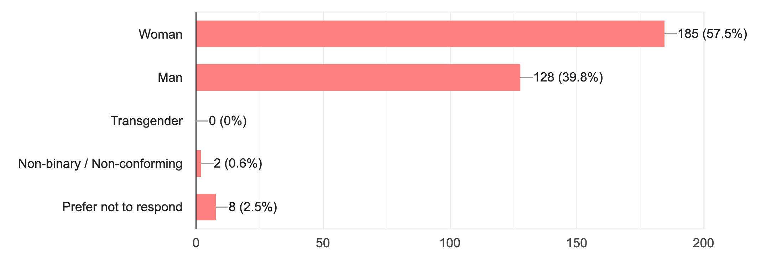
2. Gender Identity: select all that apply⁶.
SURVEY PARTICIPANTS

Slide 75
SURVEY PARTICIPANTS
3. What race or ethnicity best describes you? Choose one⁶.
American Indian or Alaskan Native – 0.3% (1)
Asian or Pacific Islander - 0
Black or African American – 5.6% (18)
Hispanic or Latinx – 0.9% (3)
White – 87.3% (281)
Multiple Ethnicity – 1.2% (4)
Other - 0
Prefer not to respond – 4.7% (15)

Slide 76
SURVEY PARTICIPANTS
4. In what conference is your home congregation?⁶

Slide 77
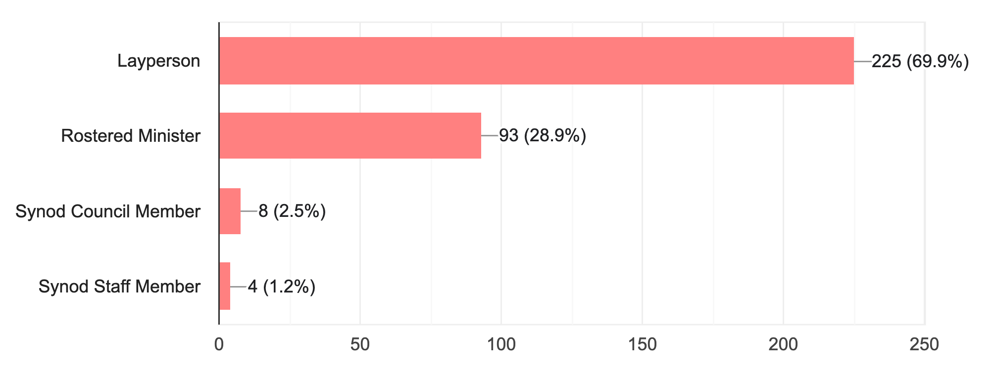
SURVEY PARTICIPANTS
5. ELCA Roster Status: please check all that apply.⁶

Slide 78
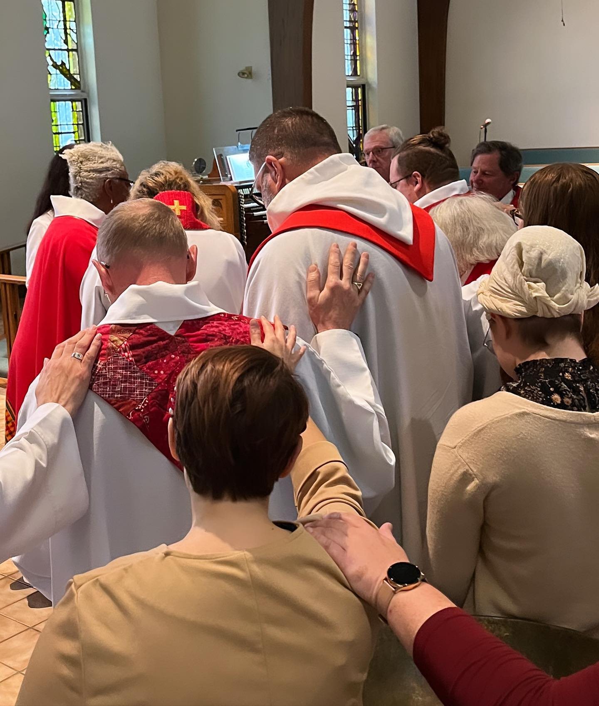
The following characteristics might be seen as helping a pastor to thrive. As you consider the role of bishop, rate each of these qualities on a scale from 1 to 5 with 1 being critical to thrive as a bishop and 5 being optional for a bishop.
QUALITIES TO THRIVE AS BISHOP
SURVEY RESPONSES: QUALITIES TO THRIVE

Slide 79
DEEP SPIRITUAL HEALTH
1 – Critical to thrive as a bishop (246)
2 – (48)
3 – (88)
4 – (7)
5 – Optional for a bishop (12)
SURVEY RESPONSES: QUALITIES TO THRIVE

Slide 80
AN ABILITY TO CAST VISION AND SHARE THE BIG PICTURE
1 – Critical to thrive as a bishop (228)
2 – (60)
3 – (13)
4 – (9)
5 – Optional for a bishop (13)
SURVEY RESPONSES: QUALITIES TO THRIVE

Slide 81
SKILLED AND EMPATHETIC LISTENER
1 – Critical to thrive as a bishop (180)
2 – (102)
3 – (21)
4 – (9)
5 – Optional for a bishop (11)
SURVEY RESPONSES: QUALITIES TO THRIVE

Slide 82
ABILITY TO DELEGATE AND MANAGE OTHERS
1 – Critical to thrive as a bishop (182)
2 – (100)
3 – (24)
4 – (5)
5 – Optional for a bishop (12)
SURVEY RESPONSES: QUALITIES TO THRIVE

Slide 83
EMOTIONAL INTELLIGENCE AND SELF-AWARENESS
1 – Critical to thrive as a bishop (190)
2 – (198)
3 – (11)
4 – (11)
5 – Optional for a bishop (12)
SURVEY RESPONSES: QUALITIES TO THRIVE

Slide 84
ABILITY TO BUILD TRUST
1 – Critical to thrive as a bishop (229)
2 – (69)
3 – (5)
4 – (8)
5 – Optional for a bishop (12)
SURVEY RESPONSES: QUALITIES TO THRIVE

Slide 85
COMMITTED TO SOCIAL JUSTICE AND CIVIC RENEWAL
1 – Critical to thrive as a bishop (142)
2 – (100)
3 – (35)
4 – (21)
5 – Optional for a bishop (25)
SURVEY RESPONSES: QUALITIES TO THRIVE

Slide 86
PASSION AND ENTHUSIASM FOR LEADING THE CHURCH
1 – Critical to thrive as a bishop (242)
2 – (48)
3 – (14)
4 – (6)
5 – Optional for a bishop (13)
SURVEY RESPONSES: QUALITIES TO THRIVE

Slide 87
CALM AND GENTLE SPIRIT
1 – Critical to thrive as a bishop (105)
2 – (110)
3 – (66)
4 – (25)
5 – Optional for a bishop (17)
SURVEY RESPONSES: QUALITIES TO THRIVE

Slide 88
ABILITY TO PERSEVERE
1 – Critical to thrive as a bishop (154)
2 – (118)
3 – (28)
4 – (13)
5 – Optional for a bishop (10)
SURVEY RESPONSES: QUALITIES TO THRIVE

Slide 89
A COMMITTED EVANGELIST
1 – Critical to thrive as a bishop (122)
2 – (116)
3 – (61)
4 – (17)
5 – Optional for a bishop (7)
SURVEY RESPONSES: QUALITIES TO THRIVE

Slide 90
SPIRITUAL MENTOR
1 – Critical to thrive as a bishop (138)
2 – (93)
3 – (63)
4 – (16)
5 – Optional for a bishop (13)
SURVEY RESPONSES: QUALITIES TO THRIVE

Slide 91
GIFTED PREACHER
1 – Critical to thrive as a bishop (97)
2 – (111)
3 – (85)
4 – (16)
5 – Optional for a bishop (14)
SURVEY RESPONSES: QUALITIES TO THRIVE

Slide 92
TALENTED WRITER
1 – Critical to thrive as a bishop (44)
2 – (135)
3 – (102)
4 – (27)
5 – Optional for a bishop (15)
SURVEY RESPONSES: QUALITIES TO THRIVE

Slide 93
WILLINGNESS TO FULLY DISCERN THE HEART OF A PROBLEM AND ENGAGE IN CREATIVE PROBLEM SOLVING
1 – Critical to thrive as a bishop (202)
2 – (89)
3 – (10)
4 – (10)
5 – Optional for a bishop (12)
SURVEY RESPONSES: QUALITIES TO THRIVE

Slide 94
STRONG UNDERSTANDING OF ELCA STRUCTURES AND CONSTITUTIONS
1 – Critical to thrive as a bishop (160)
2 – (89)
3 – (38)
4 – (17)
5 – Optional for a bishop (19)
SURVEY RESPONSES: QUALITIES TO THRIVE

Slide 95
REALISTIC OPTIMISM AND HOPE FOR MOVING THE CHURCH FORWARD
1 – Critical to thrive as a bishop (209)
2 – (81)
3 – (12)
4 – (9)
5 – Optional for a bishop (12)
SURVEY RESPONSES: QUALITIES TO THRIVE

Slide 96
Six HIGHEST RANKING QUALITIES
Deep Spiritual Health – 246 rated as critical
Passion and Enthusiasm for Leading the Church – 242
Ability to Build Trust - 229
An Ability to Cast Vision and Share the Big Picture – 228
Realistic Optimism and Hope for Moving the Church Forward – 209
Willingness to Fully Discern the Heart of a Problem and Engage in Creative Problem Solving - 202
SURVEY RESPONSES: QUALITIES TO THRIVE

Slide 97
Church vitality can be measured in several ways. Each of these activities can contribute to the health and well being of ministry settings. As you consider the synod, how does it currently rate in these areas?
Synod vitality⁶
Offers innovative and inspired worship.
Encourages and promotes lifelong learning for all members.
Leads and supports congregations in intentional and authentic evangelism.
An outward incarnational focus that models how to be Jesus' hands and feet.
Empower servant leadership within congregations and the larger church.
Provides opportunities to develop and nurture relationships between congregations and members.
Promotes a shared mission and common goals for the future of the synod.
Cultivates and encourages resiliency among congregations that isn't focused purely on attendance and finances.
SURVEY RESPONSES: synod vitality

Slide 98
OFFERS INNOVATIVE AND INSPIRED WORSHIP
1 – Excellent (39)
2 – Good (112)
3 – Adequate (99)
4 – Somewhat Ineffective (41)
5 – Not Happening (17)
6 – Unsure (17)
SURVEY RESPONSES: synod vitality

Slide 99
ENCOURAGES AND PROMOTES LIFELONG LEARNING FOR ALL MEMBERS
1 – Excellent (22)
2 – Good (95)
3 – Adequate (98)
4 – Somewhat Ineffective (75)
5 – Not Happening (18)
6 – Unsure (17)
SURVEY RESPONSES: synod vitality

Slide 100
LEADS AND SUPPORTS CONGREGATIONS IN INTENTIONAL AND AUTHENTIC EVANGELISM
1 – Excellent (29)
2 – Good (66)
3 – Adequate (102)
4 – Somewhat Ineffective (81)
5 – Not Happening (31)
6 – Unsure (16)
SURVEY RESPONSES: synod vitality

Slide 101
AN OUTWARD INCARNATIONAL FOCUS THAT MODELS HOW TO BE JESUS’ HANDS AND FEET
1 – Excellent (55)
2 – Good (102)
3 – Adequate (90)
4 – Somewhat Ineffective (40)
5 – Not Happening (18)
6 – Unsure (20)
SURVEY RESPONSES: synod vitality

Slide 102
EMPOWERS SERVANT LEADERSHIP WITHIN CONGREGATIONS AND THE LARGER CHURCH
1 – Excellent (44)
2 – Good (89)
3 – Adequate (93)
4 – Somewhat Ineffective (57)
5 – Not Happening (25)
6 – Unsure (17)
SURVEY RESPONSES: synod vitality

Slide 103
PROVIDES OPPORTUNITIES TO DEVELOP AND NURTURE RELATIONSHIPS BETWEEN CONGREGATIONS AND MEMBERS
1 – Excellent (35)
2 – Good (66)
3 – Adequate (101)
4 – Somewhat Ineffective (70)
5 – Not Happening (36)
6 – Unsure (17)
SURVEY RESPONSES: synod vitality

Slide 104
PROMOTES A SHARED MISSION AND COMMON GOALS FOR THE FUTURE OF THE SYNOD
1 – Excellent (44)
2 – Good (95)
3 – Adequate (88)
4 – Somewhat Ineffective (57)
5 – Not Happening (24)
6 – Unsure (17)
SURVEY RESPONSES: synod vitality

Slide 105
CULTIVATES AND ENCOURAGES RESILIENCY AMONG CONGREGATIONS THAT ISN’T FOCUSED PURELY ON ATTENDANCE AND FINANCES
1 – Excellent (41)
2 – Good (74)
3 – Adequate (84)
4 – Somewhat Ineffective (72)
5 – Not Happening (35)
6 – Unsure (19)
SURVEY RESPONSES: synod vitality

Slide 106
Survey participants were asked three open ended questions. All responses were reviewed by members of the Transition Team who categorized the answers.
In the following slides, the top areas in each category have been shared, along with some more detailed thoughts.
SURVEY RESPONSES

Slide 107
In a rapidly changing culture which was dramatically impacted by the pandemic, how can the synod support congregations to accomplish God's work?⁶ Responses were reviewed by members of the Transition Team. This review provided the five answers most frequently given.
Improve Communication - both mass and individual (99)
“A more visible presence of leadership from the bishop would be helpful--visiting congregations on Sundays, putting out (well-written) statements and videos to be a voice.
Clear communication about the needs of congregations in the synod.
Keep asking “what do congregations want?”
Clearly share important updates on topics such as worship practices, particularly in a time of uncertainty such as the pandemic.
Communicate more with non-rostered leaders in congregations and make sure to follow-up on message from lay people.
SHORT RESPONSE QUESTIONS: 1A

Slide 108
In a rapidly changing culture which was dramatically impacted by the pandemic, how can the synod support congregations to accomplish God's work?
Visit (80)
“Listen to what congregations have to say. Visit them!”
Regular visitation to congregations by the bishop and synod staff. If possible, every congregation would be visited in a year.
Practice intentional accompaniment, specifically through pastoral care (prayer, active listening, mutual care and consolation, not counseling) for rostered leaders.
Congregations in the “far reaches” of the synod and those in the inner city feel that the synod staff could be more accessible. Some feel a disconnect.
Greater interaction with laity.
SHORT RESPONSE QUESTIONS: 1B

Slide 109
In a rapidly changing culture which was dramatically impacted by the pandemic, how can the synod support congregations to accomplish God's work?
Help congregations embrace new paradigms as they move forward (78)
“[The church] needs to find a way to be relevant in a society that no longer sees value in religious institutions.”
Suggest specific actions that are or will motivate congregations to adjust to the new reality.
Assist congregations in improving ability to provide streaming, etc. so that worship, meeting and other gatherings can continue to be accessed by folks inside and outside congregational membership. The pandemic gave opportunity to see that this can be done faithfully and effectively… we should learn from this.
Help congregations to adjust to more members choosing online worship, especially as they are aging, and work to [help] these members stay engaged in God's Work.
SHORT RESPONSE QUESTIONS: 1C

Slide 110
In a rapidly changing culture which was dramatically impacted by the pandemic, how can the synod support congregations to accomplish God's work?
More Training and Resources for All (63)
“Help congregations imagine ministries in new ways.”
Training for lay leaders particularly in the areas of leadership, evangelism, community development, preaching and worship practices.
Resources online and in print.
Grow a multimedia office.
Provide resources that model how congregations can work together.
Renew the Diakonia program.
Provide more ways for clergy to build collegial relationships.
SHORT RESPONSE QUESTIONS: 1D

Slide 111
In a rapidly changing culture which was dramatically impacted by the pandemic, how can the synod support congregations to accomplish God's work?
Help Congregations to Develop Shared Ministries (60)
“Encourage creativity and collaboration among and between congregations.”
Give direct and honest guidance on viability of congregations in trouble.
Encourage congregations to work together and perhaps merge or create a parish with two or three congregations so focus can be on more than just survival.
Create pathways for mergers. With dwindling attendance and budgets, we would be more effective in ministries and more faithful stewards of finances if we combined congregations.
Establish system for measuring the viability of a congregation with attending action plans.
SHORT RESPONSE QUESTIONS: 1E

Slide 112
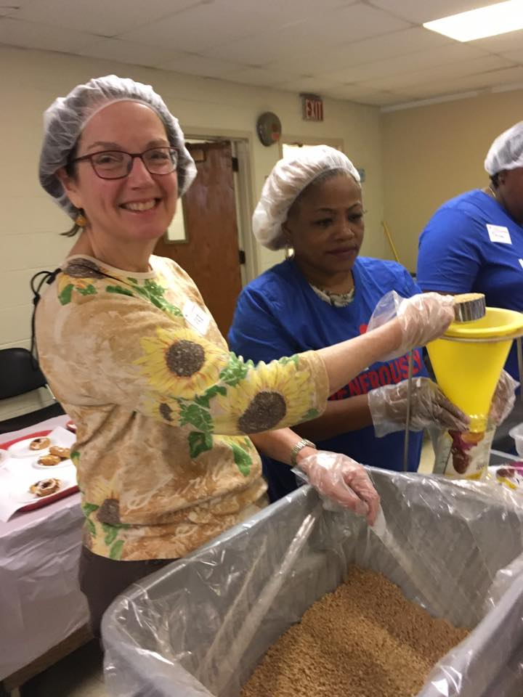
In a rapidly changing culture which was dramatically impacted by the pandemic, how can the synod support congregations to accomplish God's work?
“I believe the synod and the ELCA need to step outside the box in examining what living a full Christian life entails. It goes beyond simply showing up to a nearby building on Sundays to worship God and read the Bible, and it needs to embrace "not obviously Christian" elements of life: guidance in professions, creative expression not simply for the church, assistance in skills building, opportunities for fellowship - a whole ethos of living.”
SHORT RESPONSE QUESTIONS: 1

Slide 113
What new steps should the synod take to equip lay and rostered leaders for serving over the next five years?⁶
Provide training opportunities for laity to equip qualified individuals for better council leadership, preaching and leading worship. This could include convocations, workshops, classes at the seminary and mentoring.
SHORT RESPONSE QUESTIONS: 2A

Slide 114
What new steps should the synod take to equip lay and rostered leaders for serving over the next five years?
Provide learning opportunities and resources for rostered leaders on topics including:
Leadership skills
Transition skills
Family systems leadership for the modern church,
Bible study
Leading in a part-time congregation
Social justice issues
Technology
New mission development
Member engagement
Improved mental health resources
Opportunities for development of spiritual health and well being
Support related to pay equity and finances
SHORT RESPONSE QUESTIONS: 2B

Slide 115
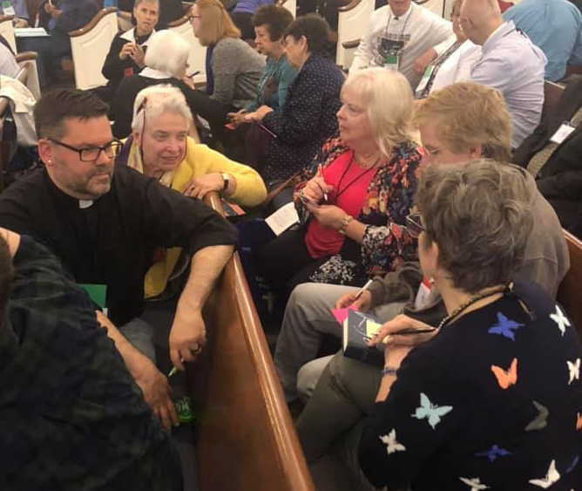
What new steps should the synod take to equip lay and rostered leaders for serving over the next five years?
Creating connections- between congregations, between congregations and the synod, among roster leaders, and with interfaith partners.
The purpose of these connections is for mutual support and to encourage working together in collaborations. This could be accomplished in a variety of ways including gathering leaders for listening times.
SHORT RESPONSE QUESTIONS: 2C

Slide 116
What new steps should the synod take to equip lay and rostered leaders for serving over the next five years?
Creation of innovative ideas and assistance with bi-vocational and multi-site ministries.
Suggested methods including creation of new ministry models, support via financial grants, training, clear vison, and better sharing of working collaborative models.
Instilling in them the confidence that we are called to serve using a wide variety of gifts and offering encouragement, training and affirmation of those gifts especially with such a critical shortage of Word and Sacrament ministers.
SHORT RESPONSE QUESTIONS: 2E

Slide 117
“Bring them (us) together without such emphasis on the boundaries of "clergy and lay" - not just "pastors forums and lay training forums" (and never the twain shall meet) and not just academic-minded training but interactions between different pastors and different laity, both online and offline, both academic and otherwise; and not merely in synod assembly and governance-based activities.
What new steps should the synod take to equip lay and rostered leaders for serving over the next five years?
SHORT RESPONSE QUESTIONS: 2

Slide 118
How can the synod help members feel connected to each other and to the whole? Responses were reviewed by members of the Transition Team. This review provided the five answers most frequently given.
Encourage Interaction (158)
“Each Church is led by a Council - but the councils have no connection with each other - Some mechanism, led by the local Conferences that enable Council connectivity would be extremely helpful.”
Synod/Church wide events, especially youth activities
Provide opportunities for fellowship
Synod ministry fair workshops
Common interest clusters
Pastor exchange
More conference gatherings
SHORT RESPONSE QUESTIONS: 3A

Slide 119
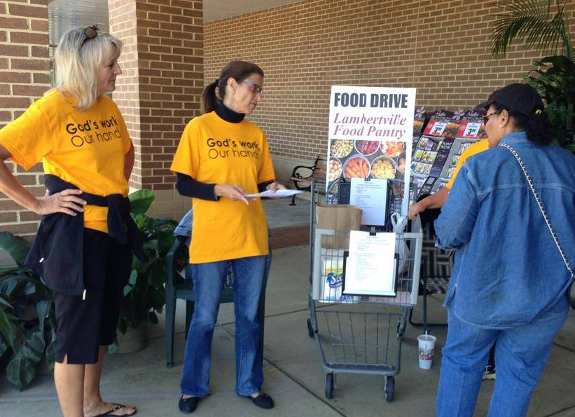
How can the synod help members feel connected to each other and to the whole?
Fortify Connections (38)
“Do you mean feel connected or actually be connected?”
Engage by identifying congregational needs, struggles
Develop a strategy to elicit trust, be transparent
Visit regularly, actively work with the congregations
Call a bishop who can network
Synod’s vision for the future
SHORT RESPONSE QUESTIONS: 3B

Slide 120
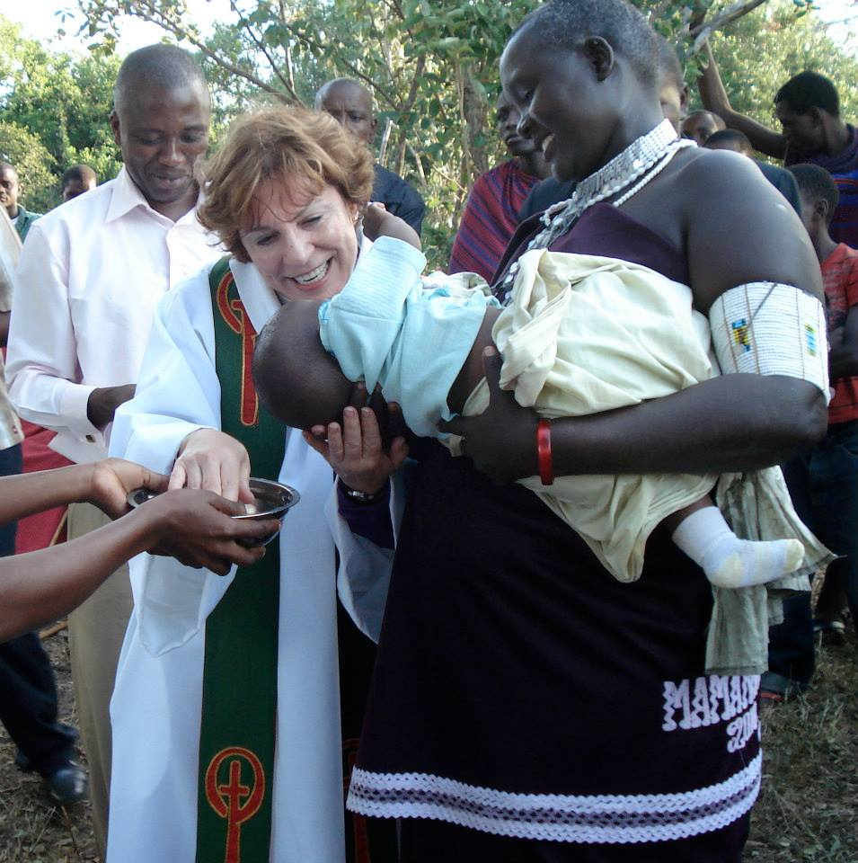
How can the synod help members feel connected to each other and to the whole?
Common Purpose (35)
“Concentrate on what we have in common as Lutherans, and not differences between people.”
Encourage congregations to work together
Create more opportunities for revival and service
Mutual understanding
Less politics, more love of one another
Stress and support serving the wider community
SHORT RESPONSE QUESTIONS: 3C

Slide 121
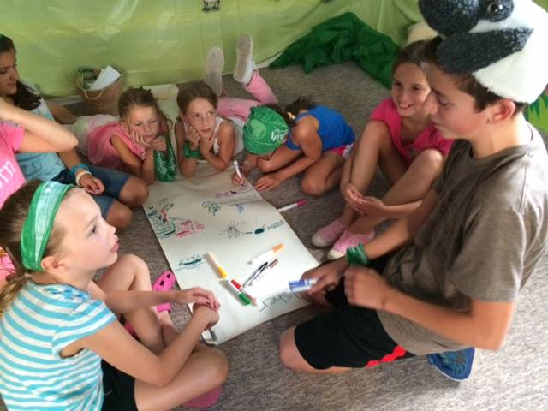
How can the synod help members feel connected to each other and to the whole?
Foster Education (27)
“…Through synod-wide worship opportunities and educational workshops.”
Provide workshops, retreats, seminars, etc. for learning and fellowship
Educate congregations on the relationship and importance of the synod
SHORT RESPONSE QUESTIONS: 3D

Slide 122
How can the synod help members feel connected to each other and to the whole?⁶
“Utilize retired lay people who have extensive experience in congregations to be listening ears, problem solvers, creative sparks for effective congregational ministry on all levels of church work. Retired does not mean leave them alone or they are no longer of value. Have the Bishop be the shepherd of rostered leaders and have a team of lay people who focus on needs of lay people. Focus on youth and young adult ministries to utilize their ministry in daily life and to coach those interested in getting into creative church work. The Bishop should not be traveling extensively away from the synod no matter how tempting or attractive that may be. Love the people in the synod and show that in as many ways as possible. Advocate for those who have skills and interested in ministry beyond the synod to serve in various capacities in the Conferences, ELCA, LWF, etc. This question is all about relationship building - letting people know you love them and are here with a listening ear and providing relevant feedback.”
SHORT RESPONSE QUESTIONS: 3

Slide 123
Current and emerging ministries

Slide 124
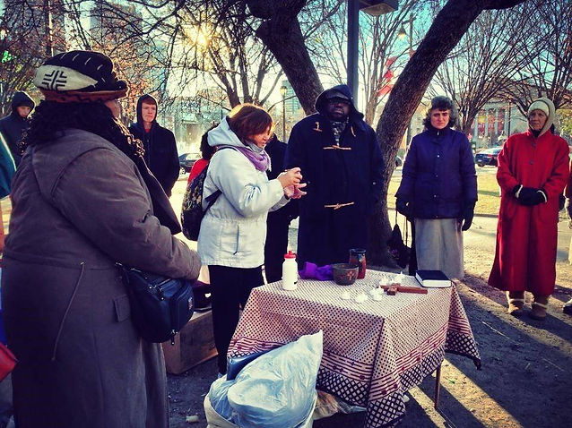
NEW & STRATEGIC MISSIONS¹²
MISSION CONGREGATIONS
The Well
Mindfulness + Church
SYNODICAL AUTHORIZED WORSHIP COMMUNITIES
The Welcome Church
Kairos Communities
Nuevo Creation
STRATEGIC MINISTRIES
Trinity, Germantown
St. Michael's Kensington
Mediator, Philadelphia
Grace, Broomall
TEEM LED CONGREGATIONS
Community of Love, Oxford
CURRENT & EMERGING MINISTRIES

Slide 125
Love Revolution: Love God and Love Neighbor
A Thriving Congregations Initiative Program

Slide 126
The Southeastern Pennsylvania Synod has received a $1,070,392 grant from Lilly Endowment Inc. to help establish a program called Love Revolution: Love God and Love Neighbor – A Thriving Congregations Initiative Program.⁸
CURRENT & EMERGING MINISTRIES

Slide 127
Over the next five years the Love Revolution will work with a cohort of congregations and their lay leaders to deepen their faith and discipleship and serve the needs of their community. As we imagine the church we are becoming post-pandemic, we will help congregations focus on this core teaching of Jesus: love God and love neighbor. Love Revolution will help congregations evolve from an institutional church built on programs and resources into a missional church built on relationships and service.⁸
LOVE REVOLUTION: LOVE GOD AND LOVE NEIGHBOR

Slide 128
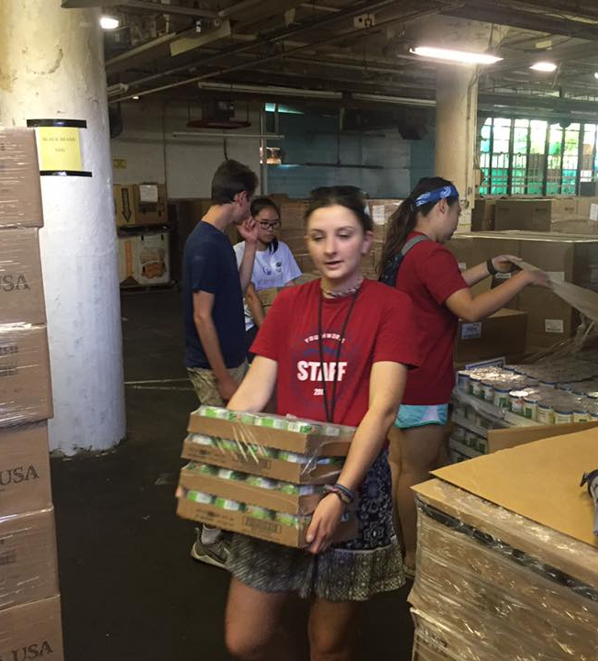
The project is being funded through Lilly Endowment’s Thriving Congregations Initiative. The aim of the initiative is to encourage the flourishing of congregations by helping them deepen their relationships with God, enhance their connections with each other, and contribute to the vitality of their communities and the world.⁸
CURRENT & EMERGING MINISTRIES

Slide 129
REFERENCES
The following people have agreed to serve as references on behalf of the Southeastern Pennsylvania Synod.
Deacon Kathleen Afflerbach
Bishop Christopher deForest
Northeastern Pennsylvania Synod, ELCA
The Rev. Dr. Charles Leonard
United Lutheran Seminary
Ms. Kate Schnaath
Contact information is available upon request from Dr. Rodrick-Schnaath at RevHRod3@gmail.com

Slide 130
END NOTES
Information for this report was culled from:
¹SEPA Synod Constitution
²2023 Mission Insite Report
³SEPA Synod Mission Proposal and Financial reports
⁴ELCA 2022 Congregational Reports
⁵A survey sent to Synod staff and deans
⁶A survey sent to Synod congregational members
⁷An interview with Bishop Patricia Davenport
⁸Synod Press Release for the “Love Revolution” grant.
⁹Synod Treasurer Janet Neff
¹⁰Census data provided by Wikipedia
¹¹SEPA Directory of Rostered Ministers
¹²Office of the Bishop, SEPA Synod
Data was collected and analyzed by team members. It was compiled into a power-point presentation by the Rev. Dr. Heidi Rodrick-Schnaath.

Slide 131
SYNOD TRANSITION TEAM
This Mission Profile was developed by the Transition Team for the 2024 Bishop Election Process in the Southeast Pennsylvania Synod.
Ms. Patricia Moore & The Rev. Dr. Heidi Rodrick-Schnaath, Co-chairs
The Rev. Ghislaine Cotnoir, the Rev. Nathan Krause,
Ms. Jill Meuser, The Rev. Thomas Russert, the Rev. Maeve Schurz,
Mr. Brett Shaw, Deacon Thomas Snyder, Mr. Martin Vaughn,
Mr. Connor Watson and Mr. Everett Wick

